Slide 1

Docker 101
Johannes Sim
Versie: November 2018 1.0

Slide 2
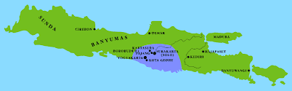




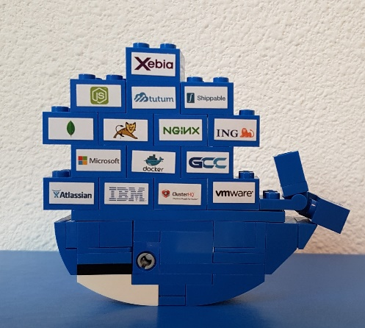
WHO is Johannes Sim?
1963
Since 1989 in IT, since 2000 with
CD journey since 2010
Agile + CD + DevOps with Docker and Azure
App 01.01.00.001
johannes.sim@centric.eu
Notes:
Mijn naam is Johannes Sim.
Ik ben een klassiek geschoolde IT-er en werk sinds 1989 in de IT.
En werk sinds 2000 met veel plezier als IT-consultant bij Centric.
Het leuke van de job is de verscheidenheid.
De rode draad bij mijn opdrachten is het leveren van software.
Vanaf 2010 ben ik in IT op reis gegaan en in aanraking gekomen met Agile, CD, DevOps, Container en Azure.
Ik ben lid van CC Azure binnen Centric en breng mijn Docker kennis in!
Voorzitter van werkgroep containerization binnen Centric
Opdrachten uitgevoerd bij KPN, ING, RWS

Slide 3
Docker 101
Goal:
Practical 101 Docker
Tell / Demo / DIY
Key take away:
What is Docker?
What can it do for you?
Audience: Centric DEV colleagues

Slide 4
CoNTENT Docker 101
My container journey
Container landscape
Workshop

Slide 5
MY Delivery journey – start
laptop
D
T
(
T
)
D
T
T
A
P
Maintenance
Project team
Maintenance team
Notes:
A&O:
Je kan uit de registry een container halen om voor je zelf te testen.
Context:
Twee overheidsorganisaties
Dev en Ops
Eigen acceptatiecriteria
Organisatie 2 heeft eigen registry.
We willen alleen de images die “groen” zijn.
Geautomatiseerd pollen we of er nieuwe versies zijn.
Draaiboek: planning
De rest in de image en configuratie voor de omgeving
We doen dit zelf met meerdere leveranciers.
Zelf zijn we ook leverancier.
Meer dan gemiddeld 5 opleveringen per dag
Om de 3 weken naar Prod

Slide 6
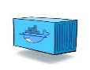


Continuous DeLIVERY (CD)
D
laptop
T
T
A
P
single source of truth
Maintenance
DevOps team
Notes:
A&O:
Je kan uit de registry een container halen om voor je zelf te testen.
Context:
Twee overheidsorganisaties
Dev en Ops
Eigen acceptatiecriteria
Organisatie 2 heeft eigen registry.
We willen alleen de images die “groen” zijn.
Geautomatiseerd pollen we of er nieuwe versies zijn.
Draaiboek: planning
De rest in de image en configuratie voor de omgeving
We doen dit zelf met meerdere leveranciers.
Zelf zijn we ook leverancier.
Meer dan gemiddeld 5 opleveringen per dag
Om de 3 weken naar Prod

Slide 7

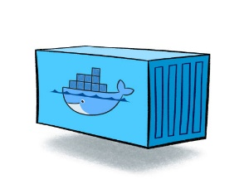
idea
Build
Ship
Run
Notes:
Plaa

Slide 8
WHY Containers (Docker)?
Software Delivery
No more: “works on my laptop!”
Time to Market
DevOps
Try something new / innovate
CI/CD (Continuous Integration / Continuous Delivery)
Time from commit to in production (cycle time)
Testing
…….
Notes:
DevOps
Time to Market
Time from commit to in production
Continuous Delivery
Build – Ship – Run
Works on my laptop
UseCase
Linux tool
Package manager

Slide 9
Notes:
Build-ship-run
Basic knowledge is essential

Slide 10
DOCKER Definition
Is the world's leading software container platform
available for developers, ops and businesses
to build, ship and run
any app
on any infrastructure.
Notes:
Waarom deze deze definitie:
World leading op dit moment
Container = Docker
Actors: dev / ops /business
ANY app (microservice / monolit / enz)
Infra (laptop / server on premise / cloud

Slide 11
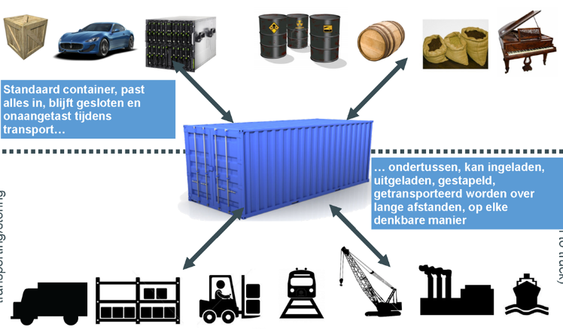
What is a container? - analogy
Notes:
What is a container?
Anlogy with Billy bookcase Ikea
A way of delivering software
Standard way

Slide 12

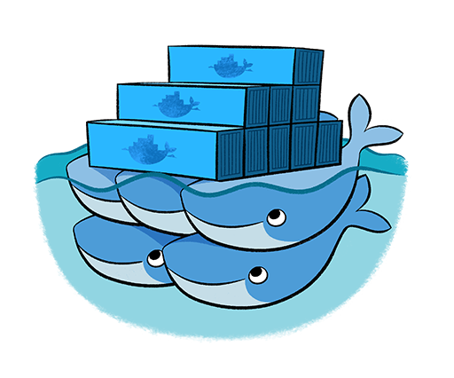
CONTAINER learning
Docker
Docker-compose
Kubernetes (K8s)
Docker-swarm
Kubernetes (K8s)

Slide 13

Container MIndset
Standard
Build– Ship – RUN AAA
Ephemeral
Immutable (consistent)
Isolation
Container in “production”
Everything what is needed and nothing more
(middleware, app code, libs, framework, binaries)
1 process – 1 task
“works on my machine!”

Slide 14
Real life DeMO - CONTAINERS
Customer facing application
Database
Database migration
Stub
Deploy on any environment with configuration files
Same containers on all environments
Deploy with 1 command

Slide 15
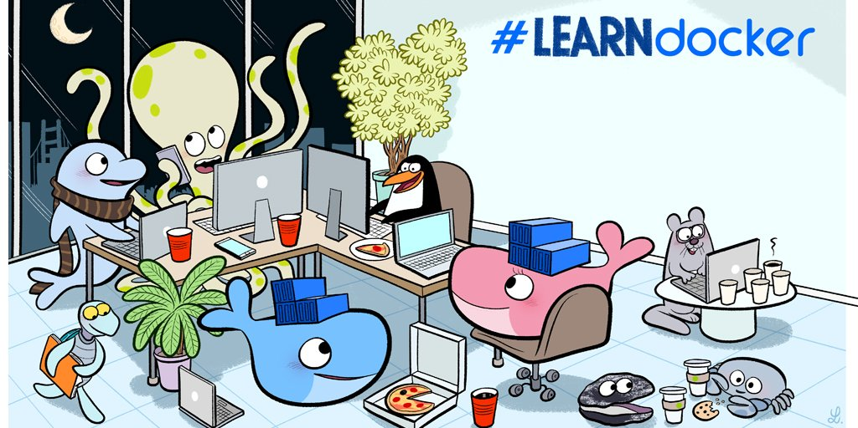
Workshop

Slide 16
Workshop
Tell + demo
Do It Yourself (DIY)
Summarize

Slide 17
Workshop Map 101
Install workshop environment & check
Container life cycle
Container
Registry
Image
Dockerfile
Example container
Build-Ship-Run workflow example

Slide 18
WoRKSHop DAY 2
Recap + Remaining day1
Volume
Network
Docker compose
Multistage build
Your build environment in Docker
Assignment Docker & microservices

Slide 19
WORKshop day 3
Recap + remaining day 1 and day 2
Kubernetes introduction
Windows containers
CI/CD example
Assignment Docker & microservices

Slide 20
Learn
Container OS
RunC
Container Engine
Containerd
Container
Docker-compose
CNCF
DockerHost
Volume
Microservices
Play with Docker
Container Image
Play with Docker
Docker Enterprise / Docker EE
DockerHub
Containers in Cloud
DockerStore
Docker swarm
Docker Engine
Docker Inc
Windows containers
Kubernets (K8s)
Docker For Desktop
Container network
DockerHub
Container Registry
Linux containers
K8S Cluster
Docker CE
Container Orchestration
Notes:
Producten -groen
Process
concepten - oranje
Standaarden – blauw
People: niet in plaat

Slide 21
INSTALL workshop environment & CHECK

Slide 22
ABOUT THIS WORKSHOP
Open source software (OSS)
Docker CE
Visual Studio Code
Work with sources in Visual Studio Code
Images from DockerHub
(Base) images
Working with CLI
PowerShell
In Visual Studio Code

Slide 23
OUR Workshop environment

Slide 24
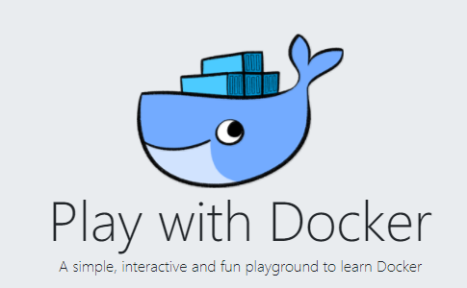

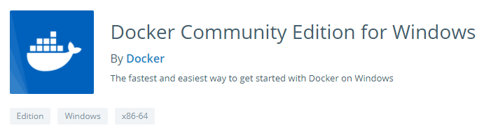
CONFIGURATION for DOCKER PLAY
Container

Slide 25
DIY: install workshop environment
Let’s do this together
Docker account
Install Docker Desktop
Play with Docker
Play with Kubernetes
Check Docker

Slide 26
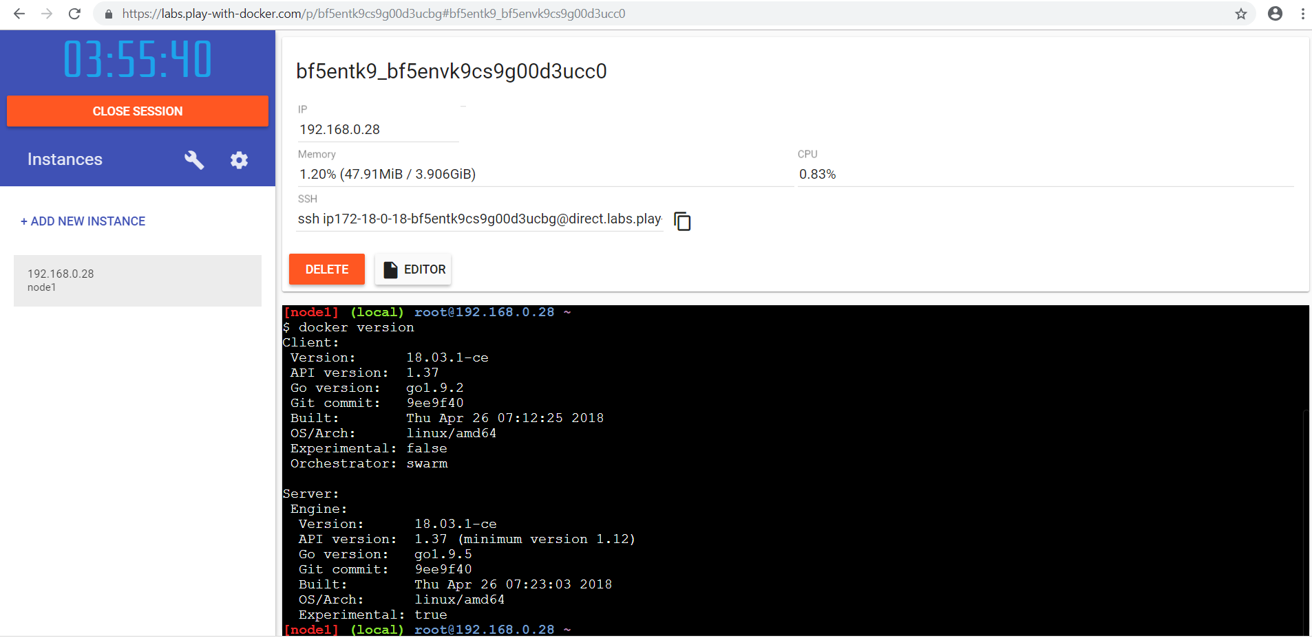
Docker PLayGROUND

Slide 27
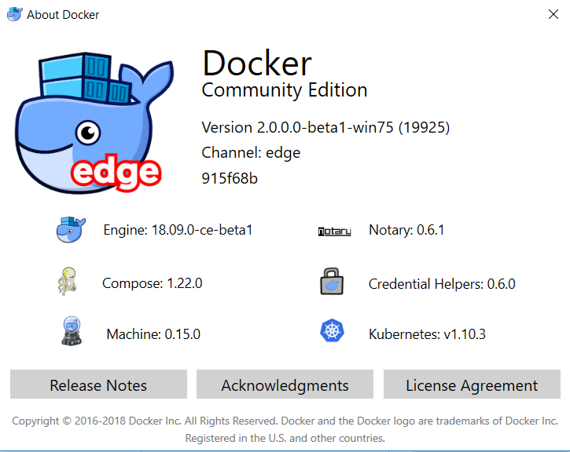
SUMMARY: OUR work environment
Easy?

Slide 28
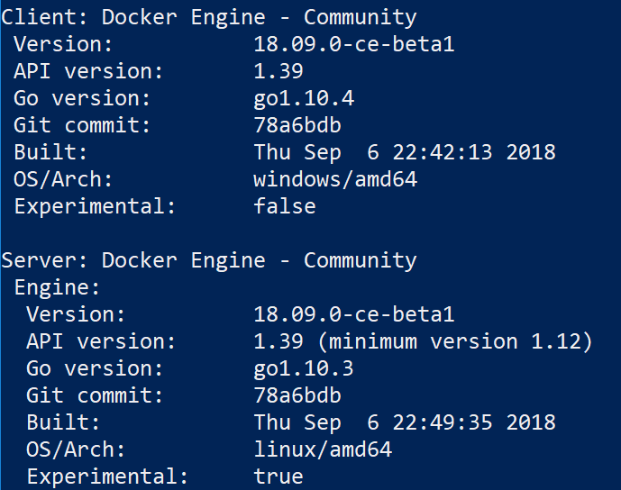
Docker working?
Client - API – Daemon
Client: Docker CLI

Slide 29
CONTAINER LIFE CYCLE

Slide 30
Container life cycle

Slide 31
Docker in a GLANCE

Slide 32
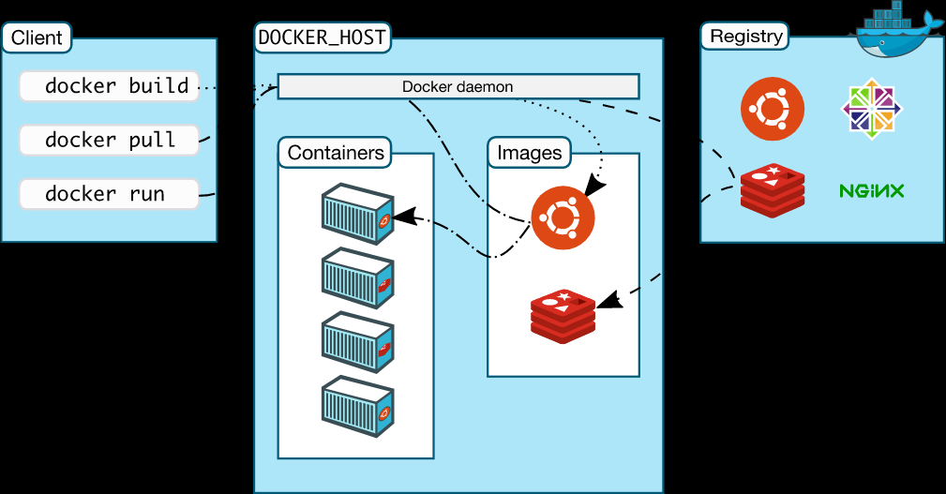
TOPIC: DOCKER ARCHITECTURE HigH LEVEL
https://docs.docker.com/engine/docker-overview/
Notes:
High Level overview
Docker CLI
Docker API
Docker Deamon
https://docs.docker.com/engine/docker-overview/

Slide 33
TOPIC: DOCKER versionS
Containers are not new (Unix: 199x)
Docker to open source: march 2013
Docker 1.13 = Docker 17.03
Year.month
CE (Community Edition)
2 release channels
Edge each month
Stable each 3 month
EE (Enterprise Edition) - paid
Notes:
Docker 1.13 = Docker 17.03
CE
2 release channels
Edge each month
Stable each 3 month
EE
Diagram
predictable

Slide 34
Docker Command LINE INTERFACE
Build
Ship
Run
Docker image ls
Docker container run
Docker pull
Docker container ls
Docker image rm
Docker push
Docker container rm
Docker image build
Docker container exec
Docker container start
Docker container stop
Docker system info
Docker system prune
Docker version
Notes:
docker system info
docker info
docker info
Command Line Interface

Slide 35
CONTAINER

Slide 36
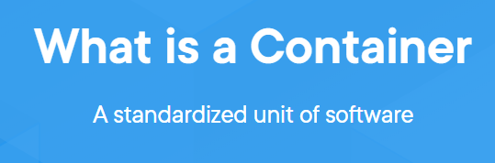
WHAT is a CONTAINER?
Standard
Build – Ship - Run AAA
Ephemeral
Immutable (consistent)
Isolation
Container in “production”
Everything what is needed and nothing more
(middleware, app code, libs, framework, binaries)
1 process – 1 task
“works on my machine!”

Slide 37
“WORKS ON MY MacHINE” EPHEmeral
Applicatie
JAVA 7
BINS/LIBS
Docker
Operating System (Kernel)
Infrastructure

Slide 38
“WORKS ON MY MACHINE” immutable
Applicatie
Applicatie
JAVA 7
JAVA 7
BINS/LIBS
BINS/LIBS
Docker
Docker
Operating System (Kernel)
Operating System (Kernel)
Laptop
Infrastructure
Production

Slide 39
“WORKS ON MY MacHINE” ISOLATION
Applicatie
Applicatie
JAVA 7
JAVA 7
BINS/LIBS
BINS/LIBS
Docker
Operating System (Kernel)
Infrastructure

Slide 40
TOPIC: PORTS
Container
Container
Container

Slide 41
DOCKER CONTAINER RUN
docker container run --name staticws -d -p 4200:80 sim007/staticws:latest
Command | Explain
docker container run | Old command: docker run
--name | Container name Name must be unique!
-d | detached – run on background in the cli
-p <hostport>:<container port> | publish 4200:80
<name image> | <registry>/<repo>/<name>:<tag>
Read more | https://docs.docker.com/engine/reference/commandline/container_run/

Slide 42
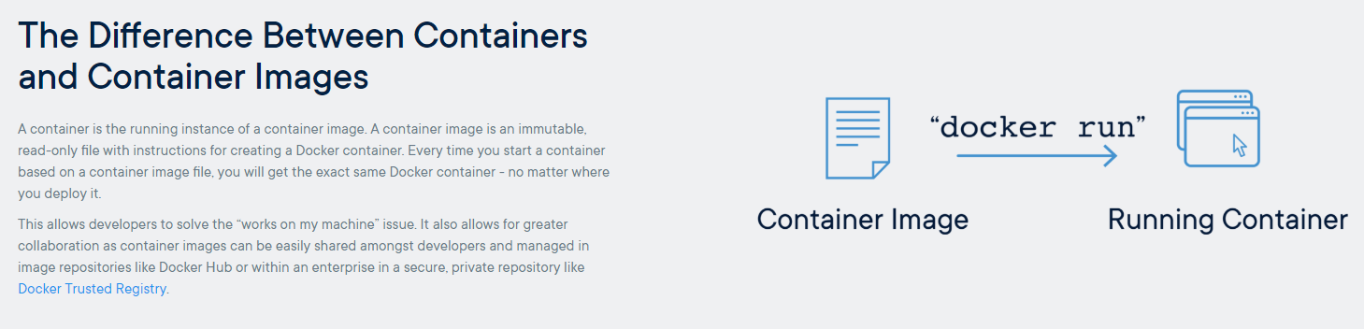
DIY
Notes:
Als voorbeeld
https://hub.docker.com/r/microsoft/dotnet-samples/
Kopie gemaakt, sim007/aspnetappdemo

Slide 43
Docker Command
Build
Ship
Run
Docker image ls
Docker container run
Docker pull
Docker container ls
Docker image rm
Docker push
Docker container rm
Docker image build
Docker container exec
Docker container start
Docker container stop
Docker system info
Docker system prune
Docker version

Slide 44
REGISTRY

Slide 45
Docker Registry - SHIP
Place for Docker container images
OS: Linux or Windows (multi-arch)
DockerHub
Public
Private
Official
DockerStore – official repo’s for enterprises
On premise
In a Docker Container
Cloud
Azure: ACR
….

Slide 46
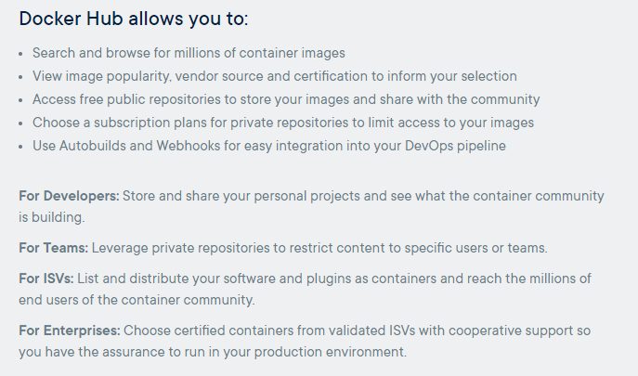
DIY
Repo name
Version tag
DockerHub

Slide 47
Images from DOCKER HUB
Image-id unique
Name: registry/repo/name:tag
Tag = version
Efficient store & download (only changed layers)
Image is first searched on local DockerHost
Tip:
Use “safe” images: official, number of pulls, rating

Slide 48
Docker Command
Build
Ship
Run
Docker image ls
Docker container run
Docker pull
Docker container ls
Docker image rm
Docker push
Docker container rm
Docker image build
Docker container exec
Docker container start
Docker container stop
Docker system info
Docker system prune
Docker version
Notes:
docker system info
docker info
docker info
Command Line Interface

Slide 49
(Container) IMAGE

Slide 50
What is an Image?
Union FS
Layers
Layer is only stored once
Compare with class
Build with Dockerfile
Best practice: Keep images small
Note: image is needed on DockerHost

Slide 51
Images
Base image
Scratch
Best practice Linux OS or Windows OS
Small Linux distro → alpine
Small Windows base image → nano server
Image for production
Images for buildprocess
Multistage build

Slide 52
intermezzo
Linux and Windows
.net core on “linux”
.net core on “Windows container”
DockerHub
Official images
Private images
Multi OS

Slide 53
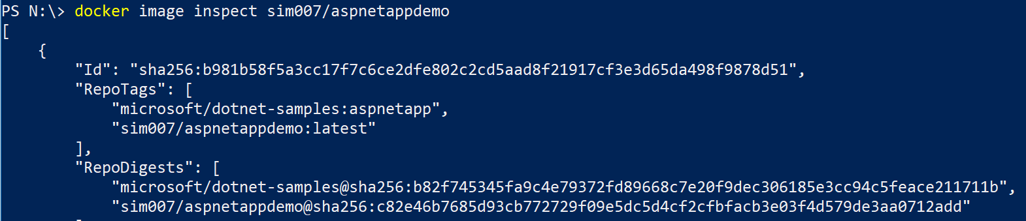
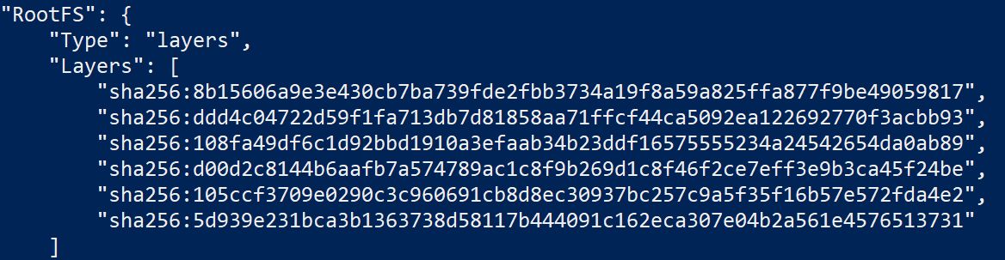
Docker image inspect
Notes:
Same image-id, different tags
layers

Slide 54
DIY
docker image ls

Slide 55
DOCKERFILE

Slide 56
DOCKERFILE
Recipe or blueprint
Each line will be layer
Each layer will be cached
Dockerize – containerize
Sources / Libs / executables on laptop
.dockerignore

Slide 57
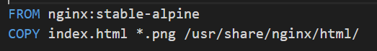
Build: (DOCKERIZE)
Dockerfile
Base image
Notes:
Container:
Iets nodig dat communiceert met de kernel van het host OS.
Je zou kunnen starten met niets – scratch.
Maar dit is niet handig, omdat je dan alle benodigde libraries en binaries zelf moet installeren.
Handiger is dus hier met een OS te beginnen.
Een mogelijk is om het OS te gebruiken van HostOS.
In de begintijd werd dit ook gedaan.
Waarom zou je dit doen. In ons geval hebben we bijvoorbeeld het volgende niet nodig:
de GUI van Linux
ook alle plugins en drivers
Docker gebruikt Linux versie Alpine (4 MB) als start.
Wij hebben ook een webserver nodig.
Dit is kant en klaar beschikbaar in de Docker store.
Ze hebben deze zelfs verpakt als image met alpine erbij.
Je haalt 1 image op maar het zijn 2 layers.
Docker is ook slim met het opslaan.
Docker slaat alleen layers op die hij nog niet heeft.
Caching!

Slide 58
DIY

Slide 59
Docker Command
Build
Ship
Run
Docker image ls
Docker container run
Docker pull
Docker container ls
Docker image rm
Docker push
Docker container rm
Docker image build
Docker container exec
Docker container start
Docker container stop
Docker system info
Docker system prune
Docker version
Notes:
docker system info
docker info
docker info
Command Line Interface

Slide 60
WHAT is?
Image = stack of layers
Made by:
Dockerfile = recipe or blue print
Docker commit – seldomly used – not in this Docker 101
Container
made from image must run on any environment
Instance
Writable layer

Slide 61
DOCKER EXAMPLES

Slide 62
Examples
Portainer
Why learn CLI commands?
Docker security benchmark
Extra
Mssql
Zap

Slide 63
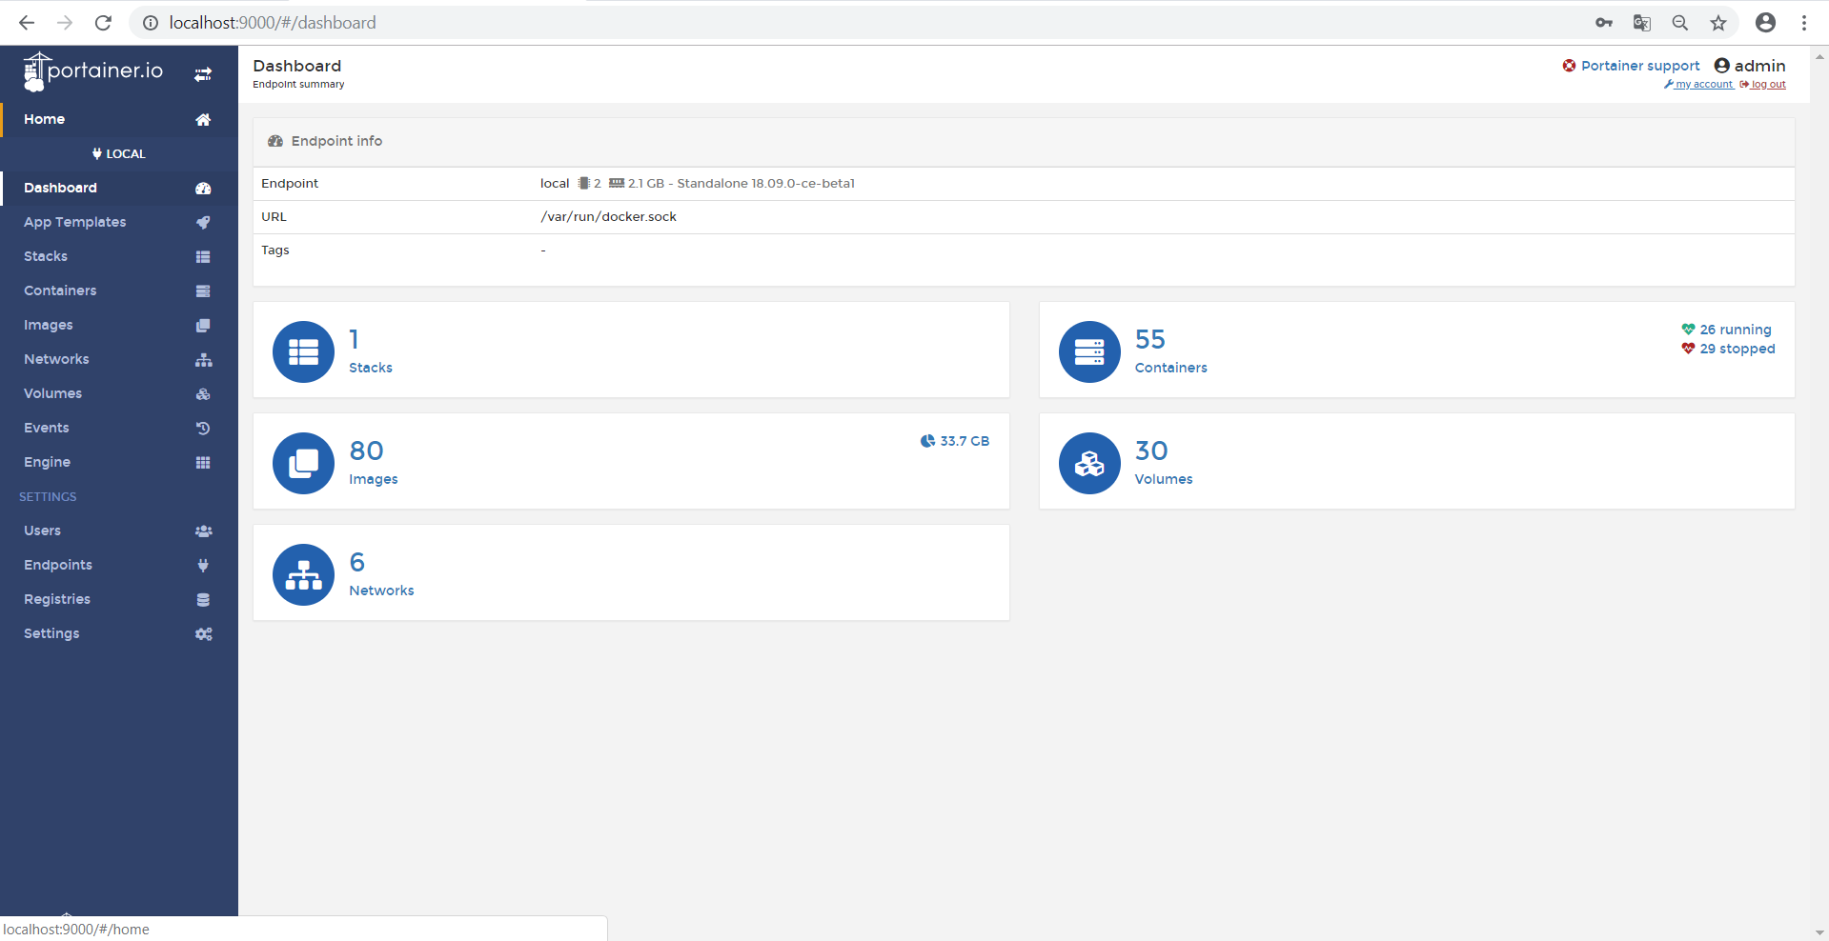
Portainer
Notes:
docker run -d -p 9000:9000 --name portainer --restart always -v /var/run/docker.sock:/var/run/docker.sock -v portainer_data:/data portainer/portainer

Slide 64
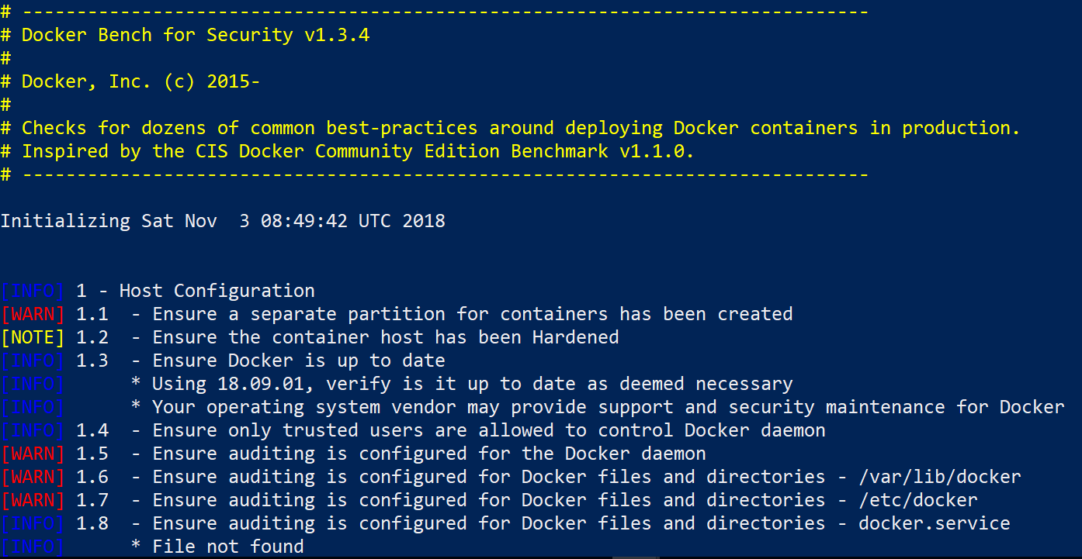
Docker Security bench

Slide 65

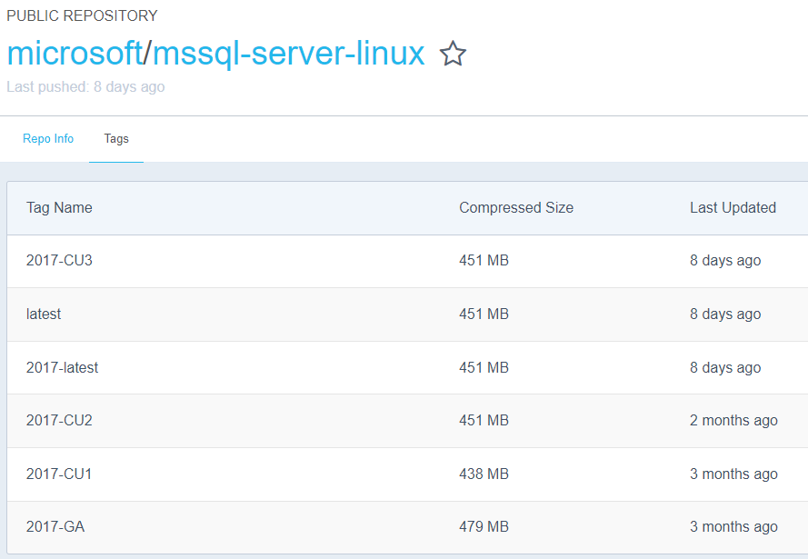
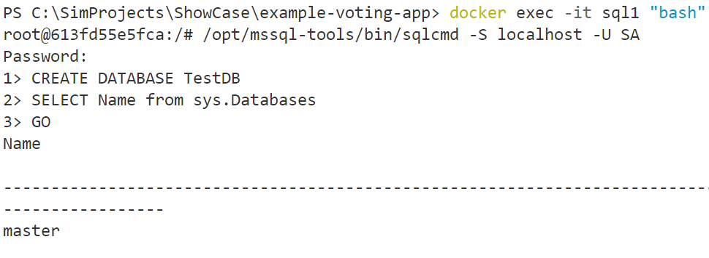
Extra: MSSQL
https://docs.microsoft.com/en-us/sql/linux/quickstart-install-connect-docker
Notes:
docker run -e "ACCEPT_EULA=Y" -e "MSSQL_SA_PASSWORD=DemoSQL#1" -p 1401:1433 --name sql1 -d microsoft/mssql-server-linux:2017-latest

Slide 66
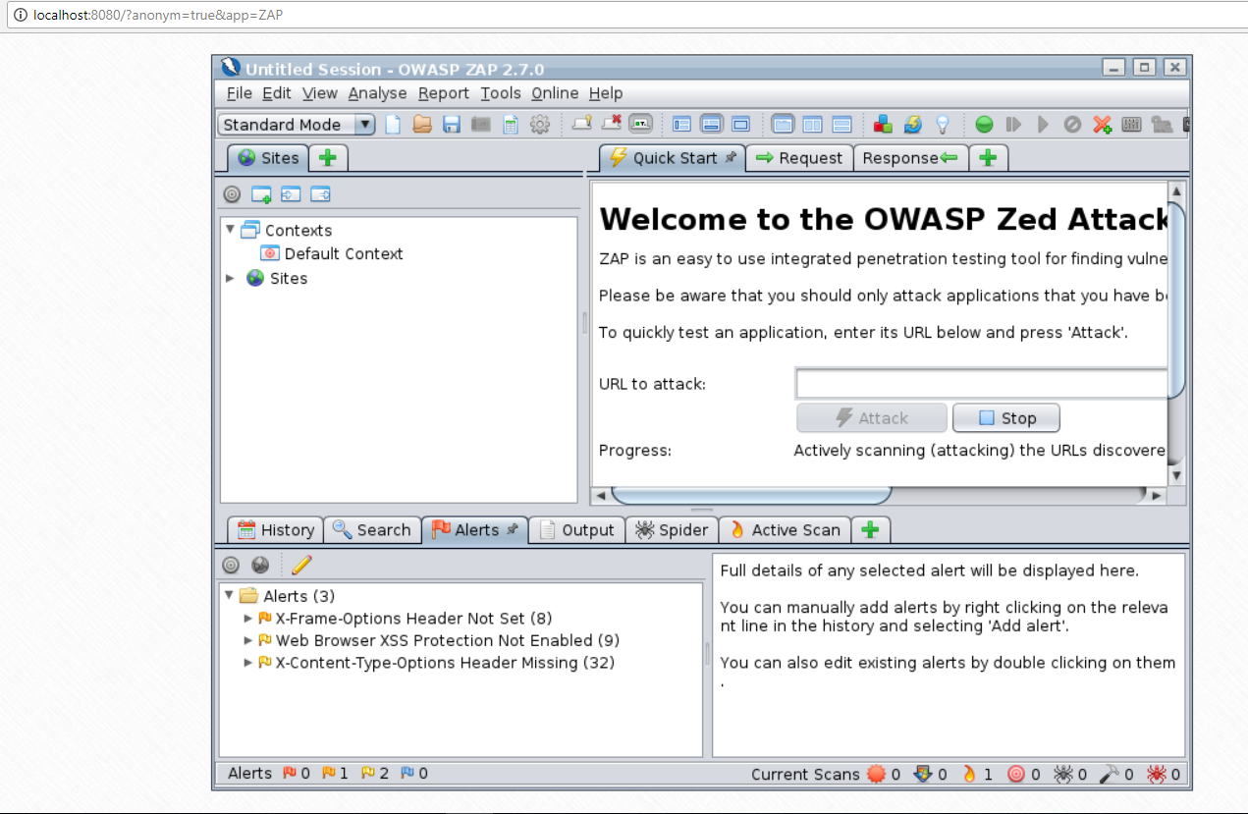
EXTRa: ZAP
https://store.docker.com/community/images/owasp/zap2docker-stable
docker run -u zap -p 9080:8080 -p 9090:8090 -i owasp/zap2docker-stable zap-webswing.sh
http://localhost:8080/?anonym=true&app=ZAP
Notes:
docker run -u zap -p 8080:8080 -p 8090:8090 -i owasp/zap2docker-stable zap-webswing.sh
http://localhost:8080/?anonym=true&app=ZAP

Slide 67
BUILD-SHIP-RUN AAA

Slide 68

OUR Container WORKFLOW
Build
Run
local
Ship
Run
“prod”
Notes:
Case: Static website
HTML pagina on webserver nginx
Code: HTML
Dockerfile
Build an image
Run container
Show result
Push to registry
Pull from registry
Run

Slide 69
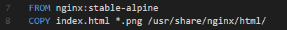
DIY

Slide 70
Some TOPICS

Slide 71
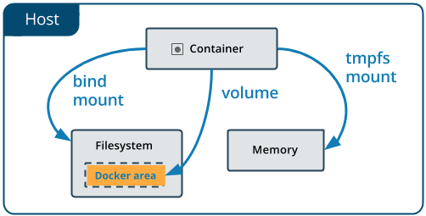
DOCKER VOLUME
DEV flow – dev mode
Changes in code without building again

Slide 72
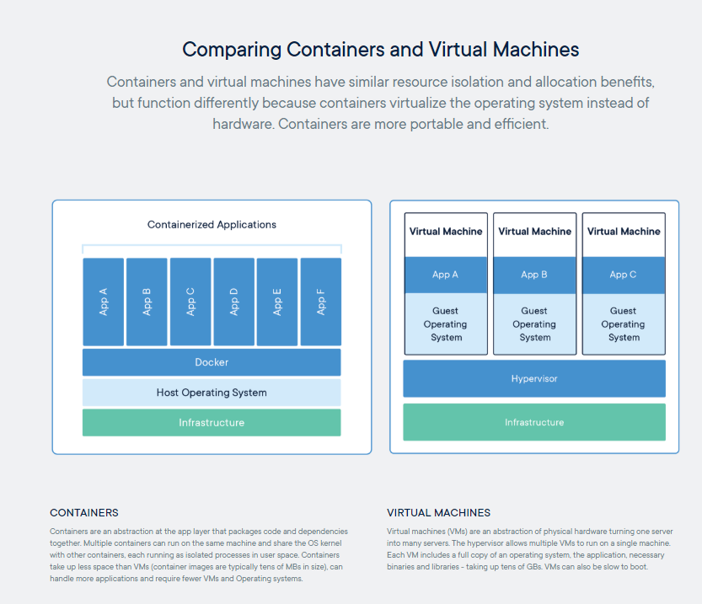
TOPIC: VIRTUAL MACHINE versus Container
Notes:
Docker containers are not VM’s
Analogy
Apartment building = VM
Apartment = Docker Container
Share of kernel
Real world
DockerHost are VM’s
Docker can also run directly on server with OS

Slide 73
GIVE some COMMANDS Alpine
 | Command
Linux version | cat /etc/*-release
 | pwd
Show directory | ls
User | whoami
Close Alpine container | Ctrl-D
Notes:
docker pull alpine
docker run -it alpine /bin/sh
Alpine
cat /etc/*-release
Pwd
Ls
Whoami
exit
docker ps

